Slide 1
MACHINE LEARNING FOR DETECTION OF SPAM
Project Guide: Members:
Mr. M L Phaneendra B. Sita Rama Krishna (150030138).
(Asst.Prof) P. Vamshi (150030738).

Slide 2
Abstract
We get hundreds of messages each day, it is difficult for us to say which of them are relevant. We face this problem of spam messages every day. Spam severely risks an internet company's reputation. These days, most of the brands and companies use spam as a source of publicity for their products and services. It can be observed in most popular mailing services that spam filters are being biased for the profit from the ads, i.e. they are allowing some exception for some companies that pay for promotion. This is not an ethical practice, but it is very profitable for their business for sure. Our aim is to build a spam detector using machine learning in python with the packages NLTK. it can state a stated message is spam or not. It can be implemented by using Bayes’ Theorem, a simple yet powerful theorem.
Machine learning empowers investigation of huge amounts of information. While it by and large conveys quicker, more precise outcomes with the end goal to distinguish productive chances or perilous dangers, it might likewise require extra time and assets to prepare it appropriately. Consolidating machine learning with AI and subjective advances can make it much more powerful in handling huge volumes of data.
It is important for ever in this technology era to learn how to build small machine learning systems for performing our day to day tasks it improves efficiency and accuracy.
So, our aim is to build and train a system ourselves for the detection of spam with the help of PYTHON packages.

Slide 3
Introduction
Machine learning is a subdivision of Artificial intelligence (AI) that gives frameworks the capacity to certainly take in and enhance as a matter of fact without being expressly modified. Machine learning revolves around the change of PC programs that can get to data and use it learn for themselves.
The way toward learning starts with perceptions or in-formation, for example, models, coordinate understanding, or guidance, with the end goal to search for examples in information and settle on better choices later de-pendent on the precedents that we give. The essential point is to permit the PCs to learn consequently without human mediation or help and alter activities as needs are. Some machine learning techniques
Machine learning algorithms are characterized as un-supervised and supervised.
Supervised machine learning algorithms can apply what has been realized in the past to new information utilizing marked models to foresee future occasions. Be-ginning from the examination of a known preparing dataset, the learning calculation delivers a deduced capacity to make forecasts about the yield esteems. The frame-work can offer concentrations to any new commitment after suitable preparing. The learning calculation can likewise contrast its yield and the right, proposed yield and discover blunders with the end goal to adjust the model in like manner.

Slide 4
Interestingly, unsupervised machine learning calculations are utilized when the data used to prepare is neither characterized nor named. Unsupervised learning contemplates how frameworks can derive a capacity to depict a concealed structure from unlabelled information. The framework doesn't make sense of the correct yield, yet it investigates the information and can attract deductions from datasets to depict concealed structures from unlabelled information.
The semi-supervised machine is a class of machine learning assignments and systems that additionally make utilization of unlabelled data for training, normally a lit-tle measure of marked data with a lot of unlabelled data. Semi-supervised learning sandwiched between super-vised learning and unsupervised learning. Many ma-chine-learning specialists have discovered that unlabelled data, when utilized related to a little measure of labelled data, can deliver impressive change in learning precision over unsupervised learning, however without the time and costs required for supervised learning.
Reinforcement machine learning calculations is a learning technique that associates with its condition by delivering activities and finds mistakes or rewards. Ex-peri mentation seeks and postponed compensate are the most significant attributes of support learning. This technique enables machines and programming operators to consequently decide the perfect conduct inside a setting with the end goal to boost its execution. Basic re-ward input is required for the specialist to realize which activity is ideal; this is known as the Reinforcement signal.
Machine learning enables investigation of enormous amounts of data. While it, for the most part, conveys quicker, more exact outcomes with the end goal to distinguish beneficial chances or perilous dangers, it might likewise require extra time and assets to prepare it appropriately. Joining machine learning with AI and subjective advancements can make it much more viable in processing large volumes of information.

Slide 5
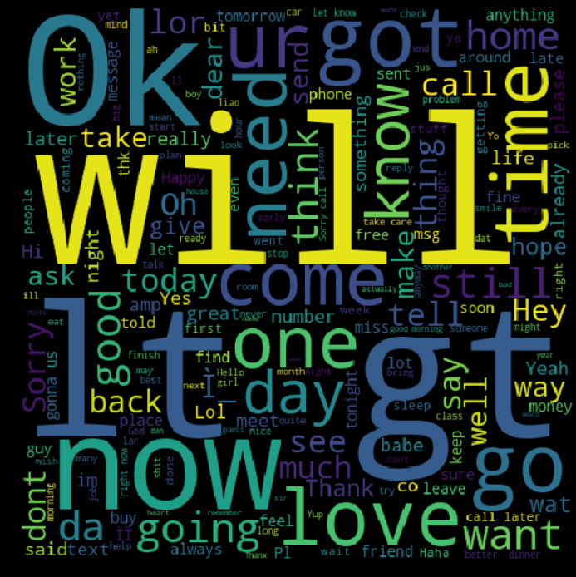

Slide 6
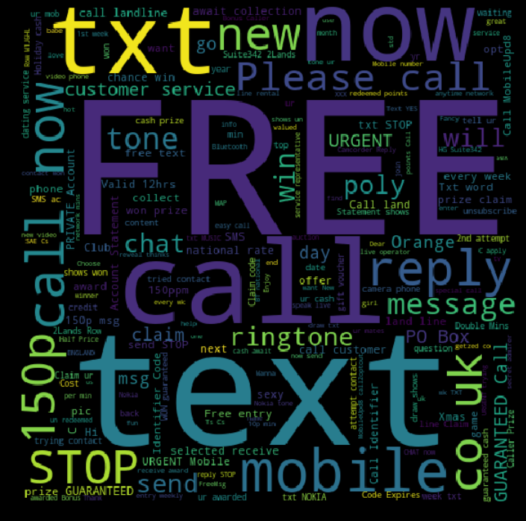

Slide 7
Literature review
A review of machine learning approaches to Spam filtering
They present a thorough survey of late improvements in the use of machine learn-ing calculations to Spam channelling, concentrating on both literary and picture-based methodologies. Rather than considering Spam shifting as a standard classifica-tion issue, we feature the significance of thinking about particular qualities of the issue, particularly idea float, in planning new channels. Two especially essential view-points not generally perceived in the writing are talked about: the difficulties in refreshing a classifier dependent on the sack of-words representation and a noteworthy distinction between two early gullible Bayes models. Generally, we reason that while critical progressions have been made in the most recent years, a few aspects stay to be investigated, particularly under more sensible assessment settings.
Survey of review spam detection using machine learning techniques.
Online reviews are often the primary factor in a customer’s decision to purchase a product or service and are a valuable source of information that can be used to govern public view on some of their products or services. Because of their influence, manufacturers, retailers are highly concerned about customer feedback and reviews. Dependence on online re-views gives rise to the potential apprehension that criminals may create false evaluations on reviews to artificially promote services and products. This practice is known as Opinion or Review Spam, where spammers manipulate reviews (i.e., making untruthful, fake or deceptive reviews) for profit. Since most online reviews are not truthful and trustworthy, it is important to develop techniques for detecting review spam. By extracting evocative features from the text using NLP, it is possible spam detection using various machine learning methods. Furthermore, reviewer information, to one side from the text itself, can be used to help in this process.

Slide 8
Detecting Spam Bots in Online Social Net working Sites: A Machine Learning Ap
As online social networking sites become more and more popular, they have also attracted the attentions of the spammers. In this paper they took Twitter, a popular micro-blogging service as an example of spam bots’ detection in social networking sites online. To differentiate the spam bots from normal ones we use machine learning approach. To enable the spam bot’s detection, three graph-based features, such as the number of friends and the number of followers, are extracted to explore the unique follower and friend associations among users on Twitter. From user’s most recent tweets content-based features are also extracted. A real data set is collected from Twitter’s publicly available information using two different methods. Evaluation experiments show that the detection system is efficient and accurate to identify spam bots in Twitter.

